Slide 1
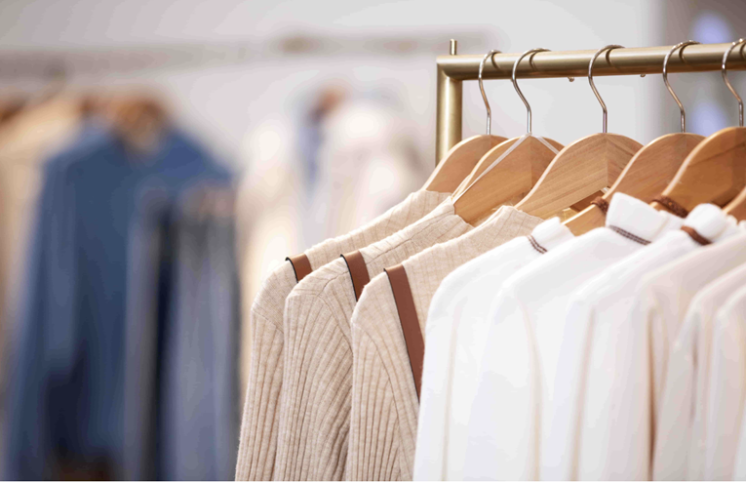
Final project
Tianyu Duan & Xinyu Xie

Slide 2
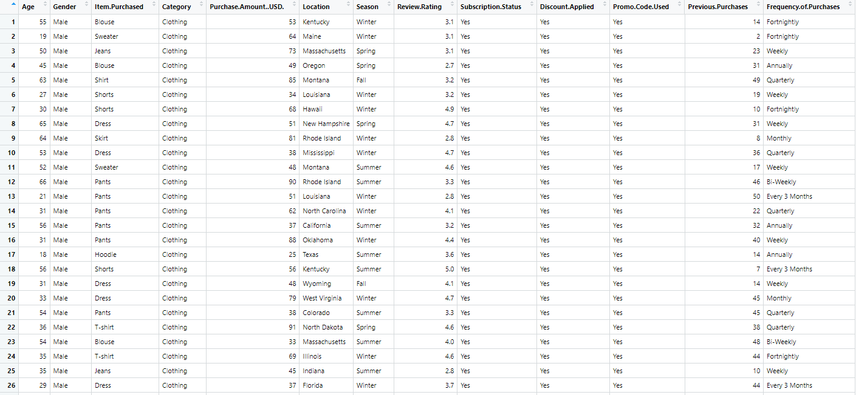
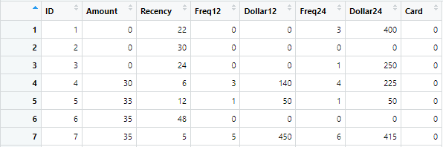
Search data and extract key information
· Our primary data was searched on Kaggle.
https://www.kaggle.com/datasets/bhadramohit/customer-shopping-latest-trends-dataset
· Our second data was found on library(Stat2Data), We intend to use this dataset to support the conclusions get from our previous dataset.

Slide 3
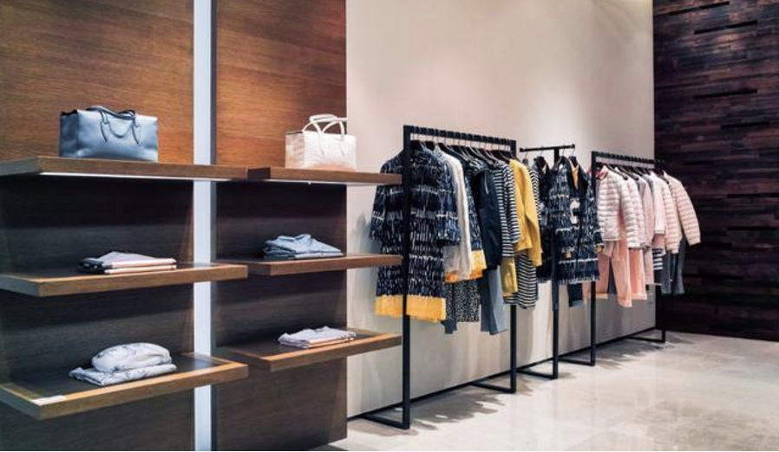
Topics we research and plan
· We plan to study the specific factors that affect clothing consumption.
· First, we found some data about clothing consumption from Kaggle. This data set is closely related to the topic we want to explore and can provide us with a lot of help.
· We plan to start by processing this data first to reduce some of the useless variables
· We intend to use the data to first make some data visualizations showing the relationship between the variables
· We intend to perform some challenging analysis fitting a regression model on recent consumption amounts
·We'll use the second dataset to support the model we got some conclusions from and fitted previously

Slide 4
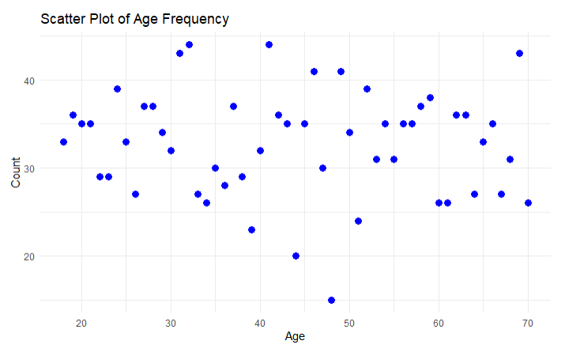
Descriptive statistics
We plan to perform the following visualizations
1, Distribution of age
2, Average consumption amount, maximum value, minimum value and standard deviation
3, Use box-and-line plots to analyze the distribution of purchase amounts for users who use discounts and those who don't
4, Draw a distribution histogram to analyze whether users of different age groups are more inclined to use discounts to help identify target consumer groups.
Distribution of age

Slide 5
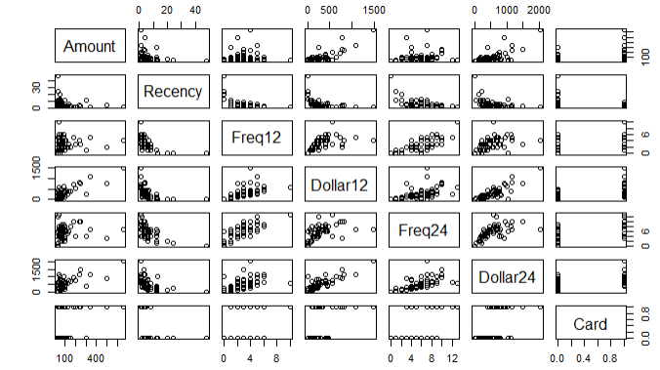






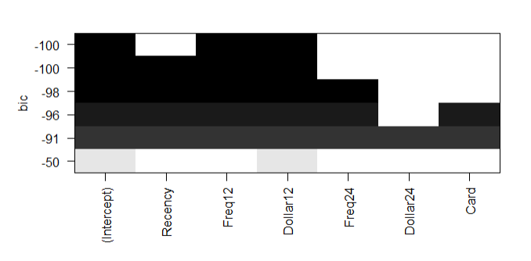
Exploratory analysis operation
ANOVA
multiple linear regression (MLR)
VIF
(variance inflation factor)
best subset method
ANCOVA
Comparisons
And
Contrasts

Slide 6
Challenges encountered
1, Visualization
2, Need to be familiar with using GitHub.

Slide 7
Thank You!!!

